Slide 1

Software requirements (swr302)
Requirements management practices (chapter 27)
Notes:
Objectives
Addresses some principles and practices of requirements management.
Student should enhance that effective management and communication among the project participants take an important role in having great requirements.
Student should only understand basic concepts. The more detail of every process will be clarified in the next chapters.

Slide 2
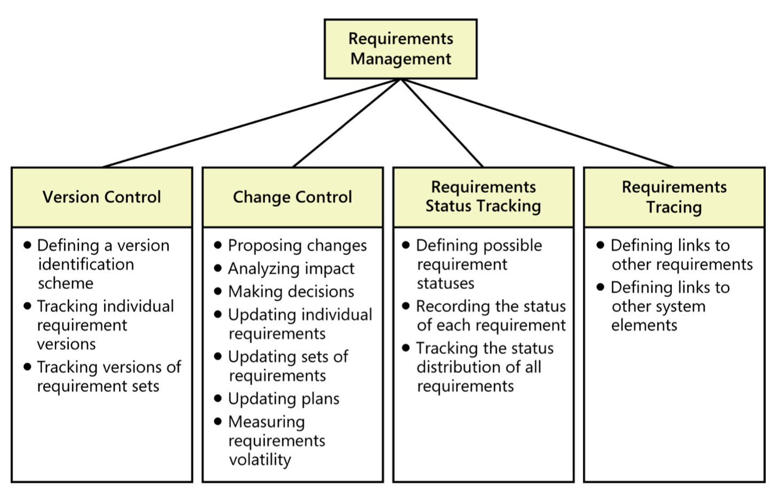
Requirements management process

Slide 3
Requirement attributes
Date the requirement was created
Current version number of the requirement
Author who wrote the requirement
Priority
Status
Origin or source of the requirement
Rationale behind the requirement
Release number or iteration to which the requirement is allocated
Stakeholder to contact with questions or to make decisions about proposed changes
Validation method to be used or acceptance criteria

Slide 4
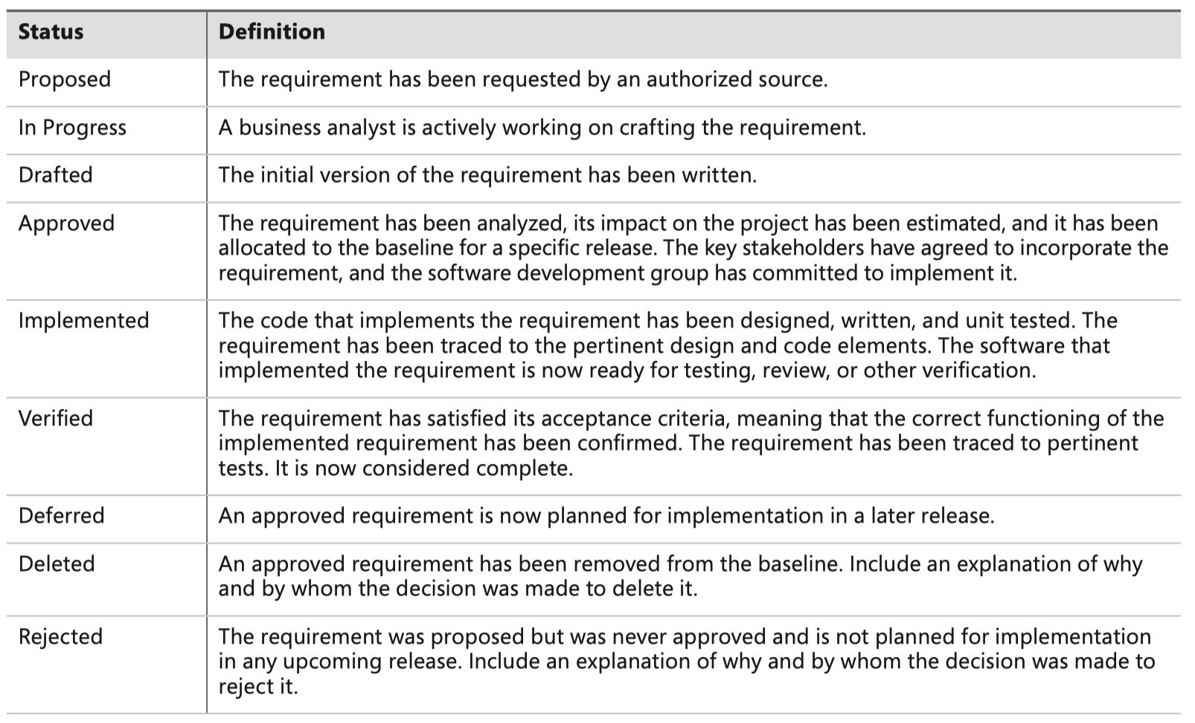
Tracking requirements status

Slide 5
Resolving requirements issues
Issues from multiple requirements reviews are collected so that no issue ever gets lost.
The project manager can easily see the current status of all issues.
A single owner can be assigned to each issue.
The history of discussion around an issue can be retained.
The team can begin development earlier with a known set of open issues rather than having to wait until the SRS is complete.

Slide 6
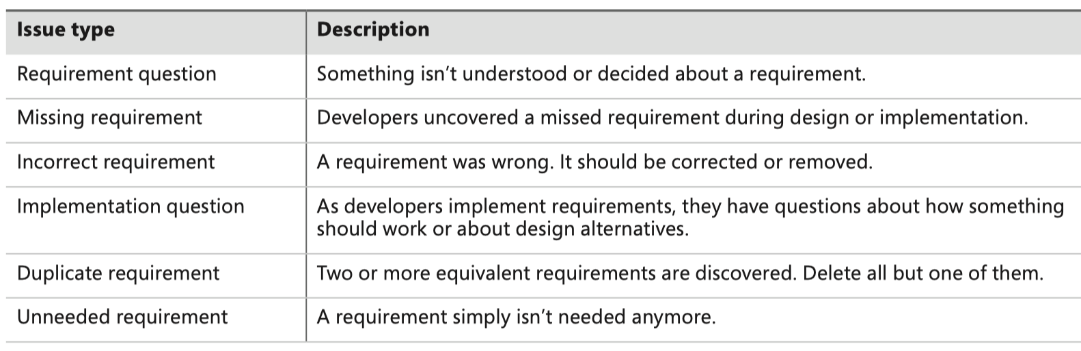
Common types of requirements issues

Slide 7
Measuring requirements effort
Planning requirements-related activities for the project
Holding workshops and interviews, analyzing documents, and performing other elicitation activities
Writing requirements specifications, creating analysis models, and prioritizing requirements
Creating and evaluating prototypes intended to assist with requirements development
Reviewing requirements and performing other validation activities
Count the effort devoted to the following activities as requirements management effort
Notes:
Count the effort devoted to the following activities as requirements management effort:
Configuring a requirements management tool for your project
Submitting requirements changes and proposing new requirements
Evaluating proposed changes, including performing impact analysis and making decisions
Updating the requirements repository
Communicating requirements changes to affected stakeholders
Tracking and reporting requirements status
Creating requirements trace information

Slide 8
Managing requirements on Agile projects
Agile projects accommodate change by building the product through a series of development iterations and managing a dynamic product backlog of work remaining to be done.
Some agile teams, particularly large or distributed teams, use an agile project management tool to track the status of an iteration & the stories allocated to it
In backlog (the story is not yet allocated to an iteration)
Defined (details of the story were discussed and understood, and acceptance tests were written)
In progress (the story is being implemented)
Completed (the story is fully implemented)
Accepted (acceptance tests were passed)
Blocked (the developer is unable to proceed until something else is resolved)

Slide 9


